Slide 1




SUPPLY CHAIN MANAGEMENT DATA ANALYSIS USING EXCEL
STUDENT NAME: R.Bhuvaneshwari
REGISTER NO : 422200027
DEPARTMENT : B.com(ISM)
COLLEGE : S.I.V.E.T College-103

Slide 2

SUPPLY CHAIN MANAGEMENT DATA ANALYSIS USING EXCEL
supply chain management

Slide 3


AGENDA
Problem Statement
Project Overview
End Users
Our Solution and Proposition
Dataset Description
Modelling Approach
Results and Discussion
Conclusion
3/21/2024 Annual Review

Slide 4

PROBLEM STATEMENT
Problem Statement:
Optimize the supply chain operations of [Company Name] to reduce lead times, minimize costs, and improve product availability, while ensuring high-quality customer service and adapting to changing market demands, despite the challenges of:-
Unpredictable demand fluctuations
Complex global sourcing and logistics
Limited visibility and control over inventory levels
Inefficient communication and collaboration among stakeholders
Increasing pressure to reduce carbon footprint and improve sustainability

Slide 5

PROJECT OVERVIEW
1. Supply chain management planning is a process of managing all the
2. process that takes part in the value addition of the raw material into the consumer product.
3. Processes involved the inflow of information; goods
and money are also managed under the same domain.
4. The flow of the goods from the manufacturer,
distributor, retailer, and the consumer

Slide 6

WHO ARE THE END USERS?
In supply chain management, the end users are typically the customers who ultimately purchase and use the products or services. They can be:
Consumers: Individual buyers who purchase products for personal use.
Businesses: Companies that buy products or services for their own operations or to resell to others.
Retailers: Stores or online platforms that sell products directly to consumers.
Distributors: Companies that buy products from manufacturers and sell them to retailers or other businesses.
Government agencies: Organizations that purchase products or services for public use or distribution.

Slide 7

OUR SOLUTION AND ITS VALUE PROPOSITION
Solution: Implementing a Cloud-based Transportation Management System (TMS).
Value Proposition:
Increased Visibility: Real-time tracking and monitoring of shipments, enabling proactive decision-making and improved communication with customers and stakeholders.
Optimized Routing: Automated route planning and optimization, reducing transportation costs by up to 15% and lowering carbon emissions.
Improved Compliance: Automated compliance with regulations and standards, reducing the risk of fines and penalties.

Slide 8
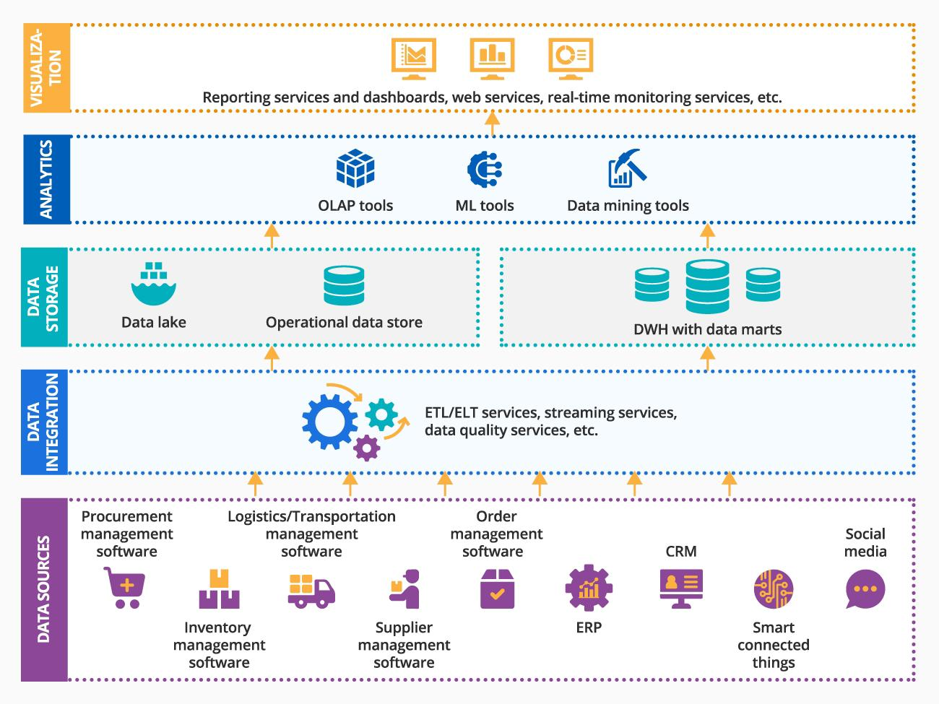
Dataset Description

Slide 9

THE "WOW" IN OUR SOLUTION
Efficiency & Cost Savings:-
1. Automate 90% of manual supply chain processes, reducing costs by 30%.
2. Cut transportation costs by 25% with optimized routing and carrier selection.
3. "Reduce inventory levels by 40% through AI-powered demand forecasting.
Visibility & Transparency:-
1.Get real-time visibility into shipment tracking, inventory levels, and supply chain disruptions.
2. Track and trace products from raw materials to end-customer delivery.
Innovation & Technology:-
1. Leverage AI-powered predictive analytics for demand forecasting and risk management.
2. Utilize blockchain for secure, transparent, and tamper-proof supply chain data.
Customer Experience:-
1.Deliver 99.9% order fulfillment accuracy and 100% on-time delivery.
2.Provide personalized customer experiences through real-time order tracking.
3. Offer flexible and agile supply chain solutions for changing customer needs.
3/21/2024 Annual Review
9

Slide 10
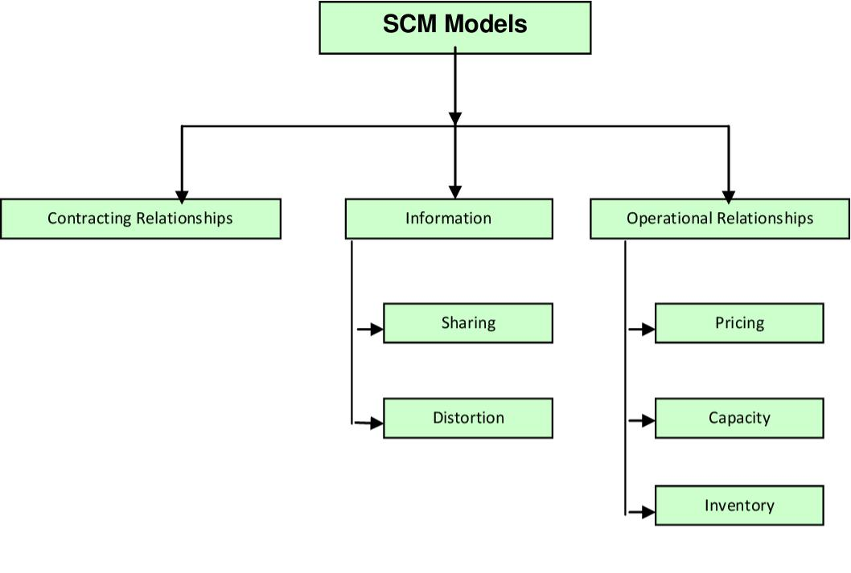
MODELLING
10

Slide 11
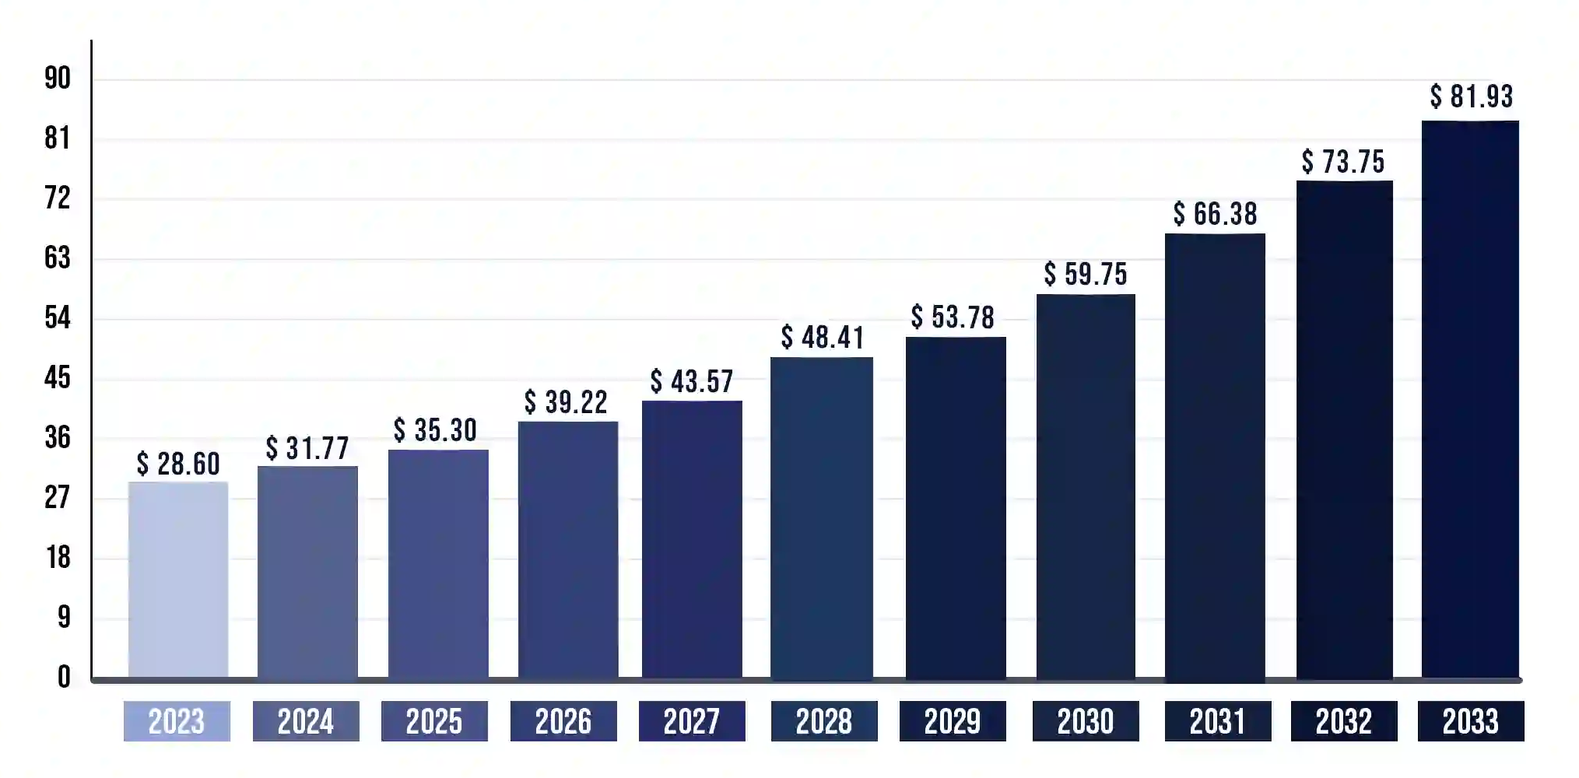
RESULTS
11

Slide 12
conclusion
In conclusion, effective Supply Chain Management (SCM) is crucial for businesses to remain competitive in today's fast-paced and globalized market. By implementing efficient SCM strategies, companies can:-
Reduce costs and improve profitability.
Enhance customer satisfaction and loyalty.
Improve agility and responsiveness to changing market conditions.
Mitigate risks and ensure business continuity.
Drive sustainability and social responsibility.
Gain a competitive advantage and establish market leadership.

